Slide 1
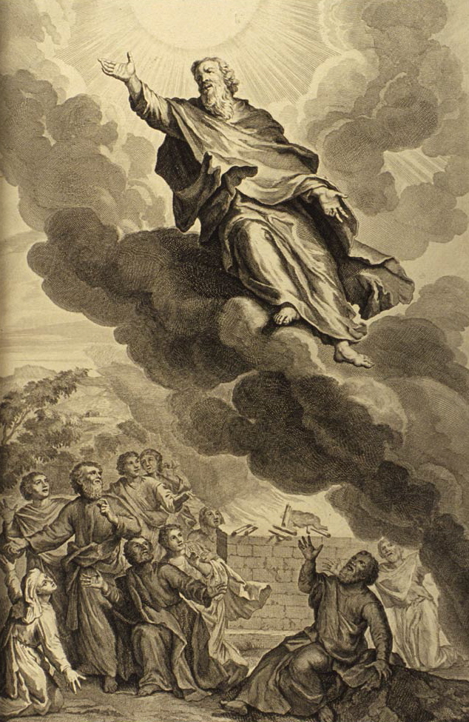
Chasing Enoch: The Man, the Myth, the Mason?
Presented to McPherson Lodge #172
July 6th , 2022
Keith Peterson, P.M., KCCH

Slide 2
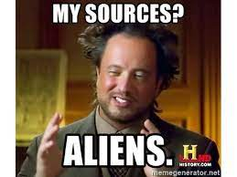
How the Chase Began
I’ll admit it….I LOVE Ancient Aliens
Did Enoch build the Great Pyramid of Giza?
My obsession took control

Slide 3
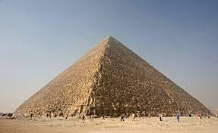
How the Chase Began
Did Enoch Build the Great Pyramid?
Too aggressive
What is Enoch’s Link to Freemasonry?
Too broad
Who is Enoch?
A place to start
“The Man, The Myth, The Mason” is born

Slide 4
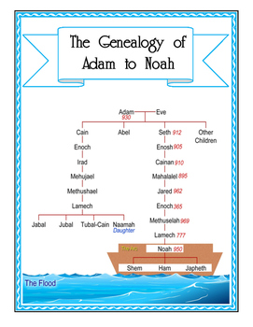
Enoch the Man
The historical record is thin
Lineage
Seventh man from Adam
Son of Jared
Father of Methuselah
Grandfather of Lamech
Great Grandfather of Noah

Slide 5
Enoch the Man
Need to reconcile the Biblical and historical timelines
Geologically the flood of Noah could have happened
Approx. 20,000 years ago
Approx. 7500 years ago
Gregorian calendar 18,000-5500 B.C.E
If Enoch was Noah’s great grandfather, he would have lived within the reconciled timeline

Slide 6
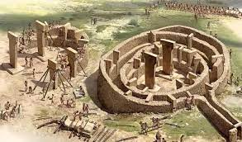
Enoch the Man
What we know
Hunter gatherers made the transition earlier than first thought
Gobekli Tepe 12,000 B.C.E
Sphinx, as early as 10,970 B.C.E
Rudimentary societal organization
Polytheism
Astronomy
Beginning of the scholarly modern civilization around 5500 B.C.E.

Slide 7
Enoch the Man
Enoch’s profile
Enoch was of Middle Eastern descent
Enoch was most likely polytheistic (prior to his encounters with the one God)
Enoch lived on the cusp of mankind’s transition from hunter-gather nomads to modern civilization
Enoch likely had a rudimentary if not marginally sophisticated understanding of astronomy

Slide 8
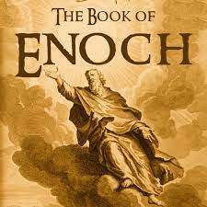
Enoch the Myth
Three Main Sources
1st Enoch
Apocryphal text in the western Biblical canon
Known as the “Book of Enoch”
Canonical in Ethiopian Kebra Nagast
Known as the “Ethiopic Book of Enoch”
2nd Enoch- Slavic in origin
3rd Enoch- Hebrew in origin
Subordinate Works
The Book of Giants, The Book of Jasher, and The Book of Jubilees

Slide 9
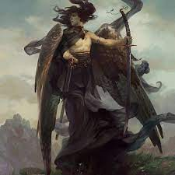
Enoch the Myth
The Book of Enoch (1st Enoch)
The fall of the Watchers
Knowledge, metallurgy, weapons
A second fall to sin
Birth of the Nephilim
Detainment of Azazel

Slide 10
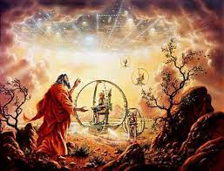
Enoch the Myth
The Book of Enoch (1st Enoch)
Enoch walks with God
Spaceships and a fantastical journey
Heaven, hellfire, bliss, premonition
A glimpse into the future
No return trip

Slide 11
Enoch the Myth
The Bile doesn’t say much…but what it DOES say….
Genesis 5:21-24
“Enoch walked with God, and he was no more; for God took him”
God helped Enoch ascend in living form
Jesus Christ, the only other with this distinction
Enoch is special
Enoch knows the “name of God”

Slide 12
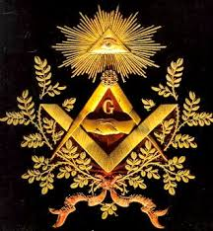
Enoch the Mason?
The question is symbolic
We know little about Enoch the man
We know little about the Biblical Enoch
Only that he walked with God, but why?
Mythical Enoch is descriptive
Creates more questions than answers
Why is Enoch prominent in Freemasonry?
Was Enoch a mason?

Slide 13
Enoch the Mason?
Blue Lodge References
Enoch 10:19
Wine, Corn, and Oil
Enoch 2:1,
“Observe ye everything that takes place in the heaven, they do not change their orbits, and the luminaries which are in the heaven, how they all rise and set in order each in its season and transgress not against their appointed order.”
Staircase and Officer Rotation

Slide 14
Enoch the Mason?
Blue Lodge References
Chapter 12 is similar to 3rd Degree narrative
“Before these things Enoch was hidden, no one of the children of men knew where he was hidden, and where he abode, and what had become of him.”
Hiram’s grave
“The murder of their beloved ones shall they see, and over the destruction of their children shall they lament, and shall make supplication unto eternity, but mercy and peace shall ye not attain.”
Hiram’s exumation
3 Parables begin and end in light
Book of the Luminaries

Slide 15
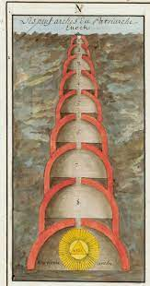
Enoch the Mason?
Scottish and York Rite
Enoch’s Vault
In which lies the Cubical Stone
Representation of the ineffable name of
Enoch walked with God…so it makes sense
If anyone would know it would be Enoch!
Enoch’s Pillars
Contain all the antediluvian knowledge
Contain knowledge of the 7 liberal arts and sciences

Slide 16
Enoch the Mason
Was Enoch a mason?
Is this the right question?
Enoch’s parables begin and end in light
The Book of Enoch, has innumerable allusions to masonic ritual degree work In apocryphal and Biblical lore
Enoch walked in heaven in the presence of God and presumably knew the name of God
Most compellingly, the name Enoch, means “the Initiator”
Was Enoch the FIRST mason?

Slide 17
The Chase Continues
Questions I uncovered along the way
The Great Pyramid is still in play- Do the first 10 chapters of Enoch refer to the deserts of Egypt and mysterious builders? When it is stated that Azazel has “rough and jagged rocks placed upon him…covering him with darkness…where he will abide forever”, is it referring to The Great Pyramid? Can you find references to both the river Nile and The Great Pyramid in Chapters 14, 16, 22 and others?
The Isis Myth- Is the Isis myth a parallel to the Enoch narrative and consequently to modern Freemasonry? Inasmuch as Isis holds esoteric knowledge, knows the name of deity, and has the power of resurrection, is she a forerunner to our practiced mythology?

Slide 18
The Chase Continues
Questions I uncovered along the way
Enoch and the LDS- Why does Enoch hold a particular prominence in the Mormon Church, whose symbolism mirrors many of the symbols of Freemasonry? Why did a research rabbit hole lead to a paper written by a BYU professor by the name of R. Grant Athay in 1968, titled “Worlds Without Number: “The Astronomy of Enoch, Abraham, and Moses”?
Hermes Trismegistus- Who is this enigmatic ancient sage, and why do references to him continue to appear on the chase for Enoch.

Slide 19
The Chase Continues
Where will the chase lead you?

Slide 20
Thank You!
Keith Peterson, P.M., KCCH
Springdale Lodge #316
doctorkeith@hotmail.com
Any Questions?

